Slide 1
Dart in Depth (Part 2) (Chapter 6, 7, 12)
Youssef N Altherwy
Dhekra Alshaieb

Slide 2
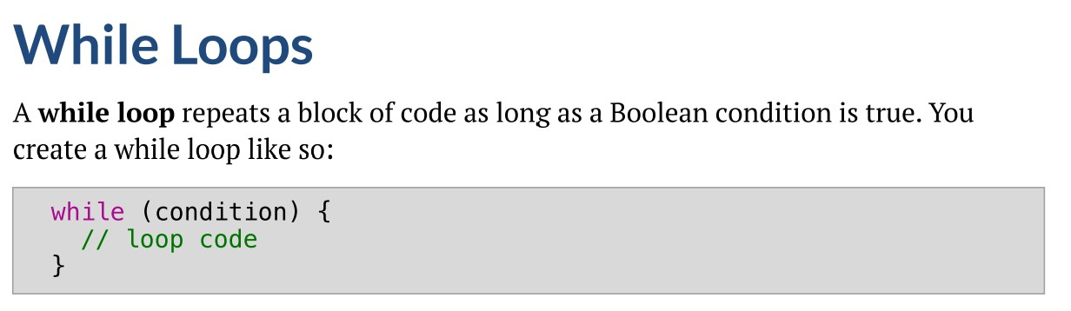
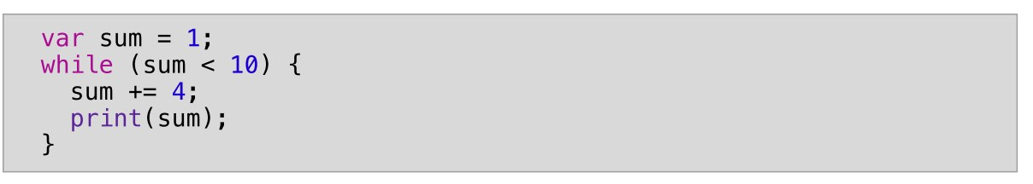

Chapter 6: Loops While Loop
Results

Slide 3
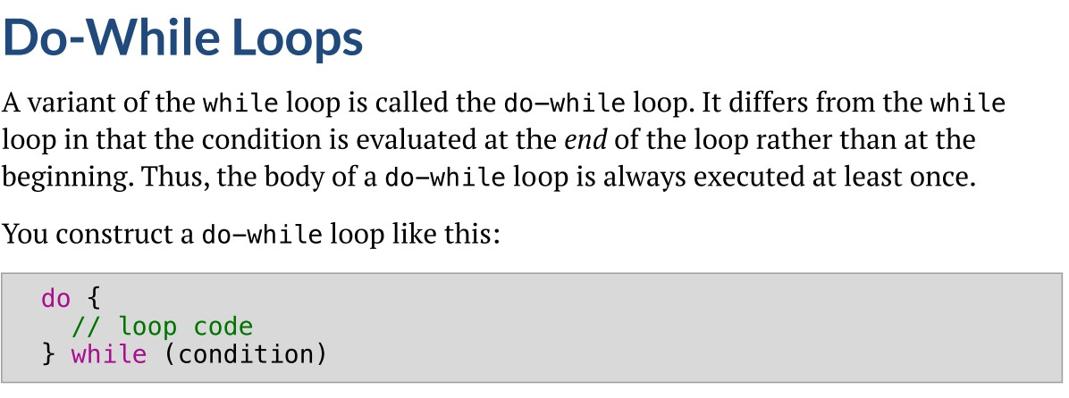
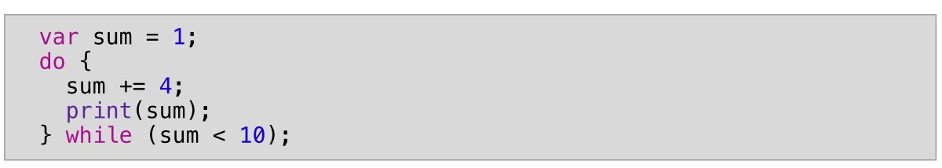

Do-While Loop
Results

Slide 4
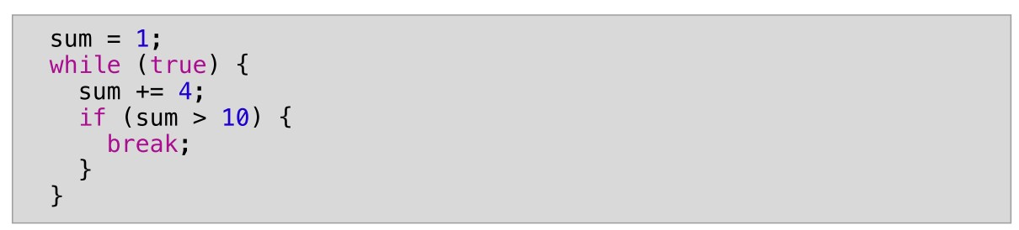
Break Out of Loops

Slide 5
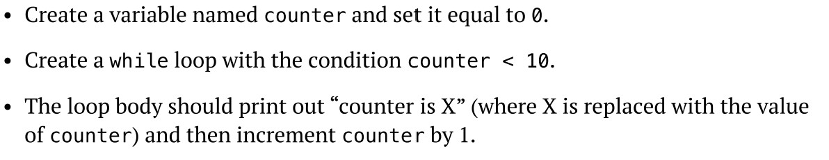
Mini Exercise

Slide 6
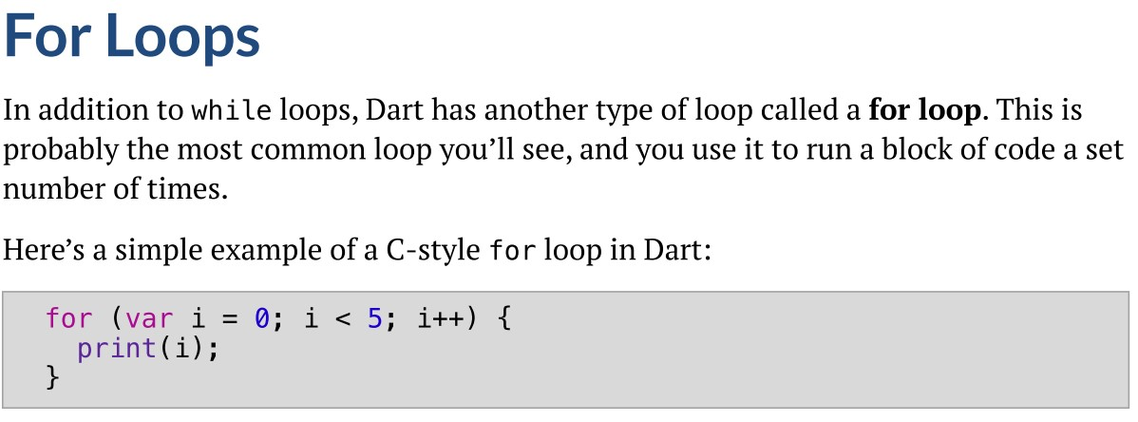

For Loop
Results

Slide 7
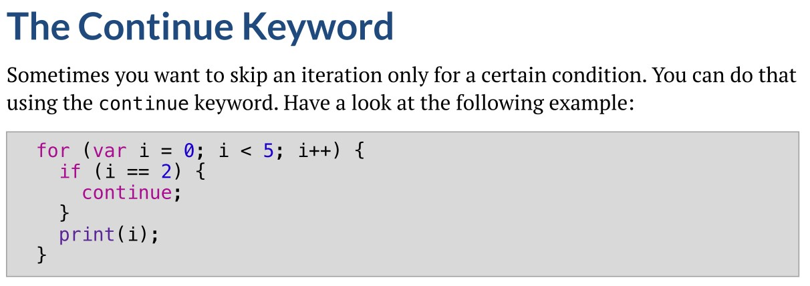

Continue Keyword
Results

Slide 8

Mini Exercise

Slide 9
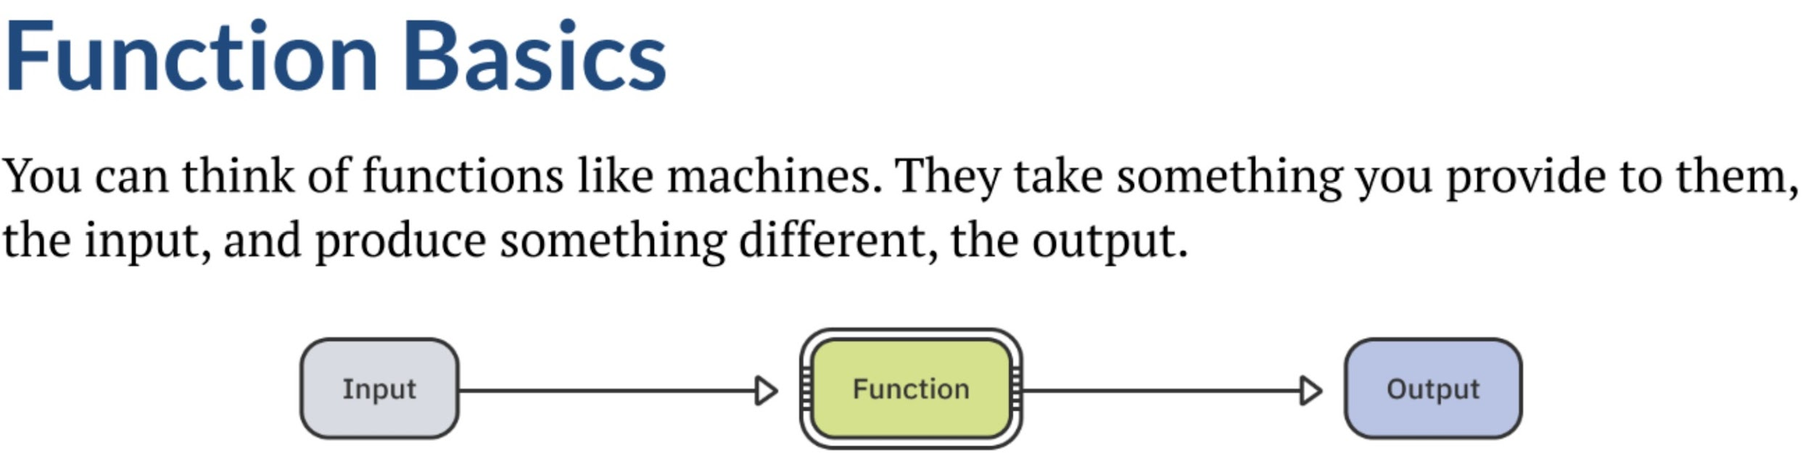
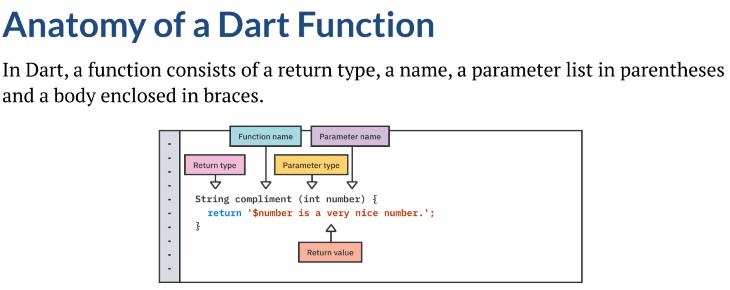
Chapter 7 Functions

Slide 10
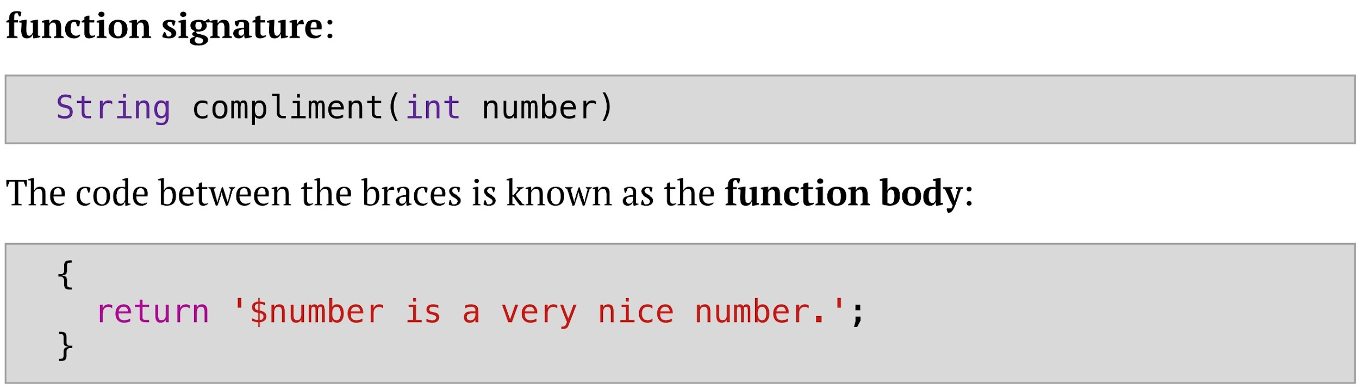
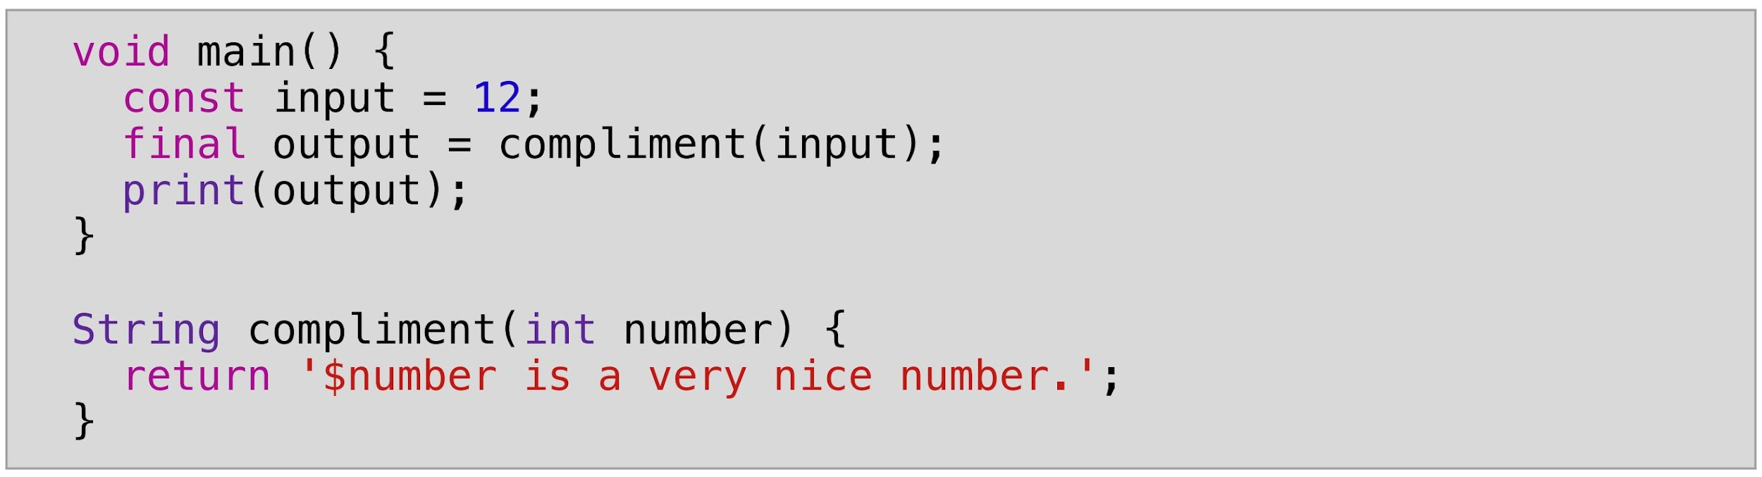
Functions
Example of a function

Slide 11
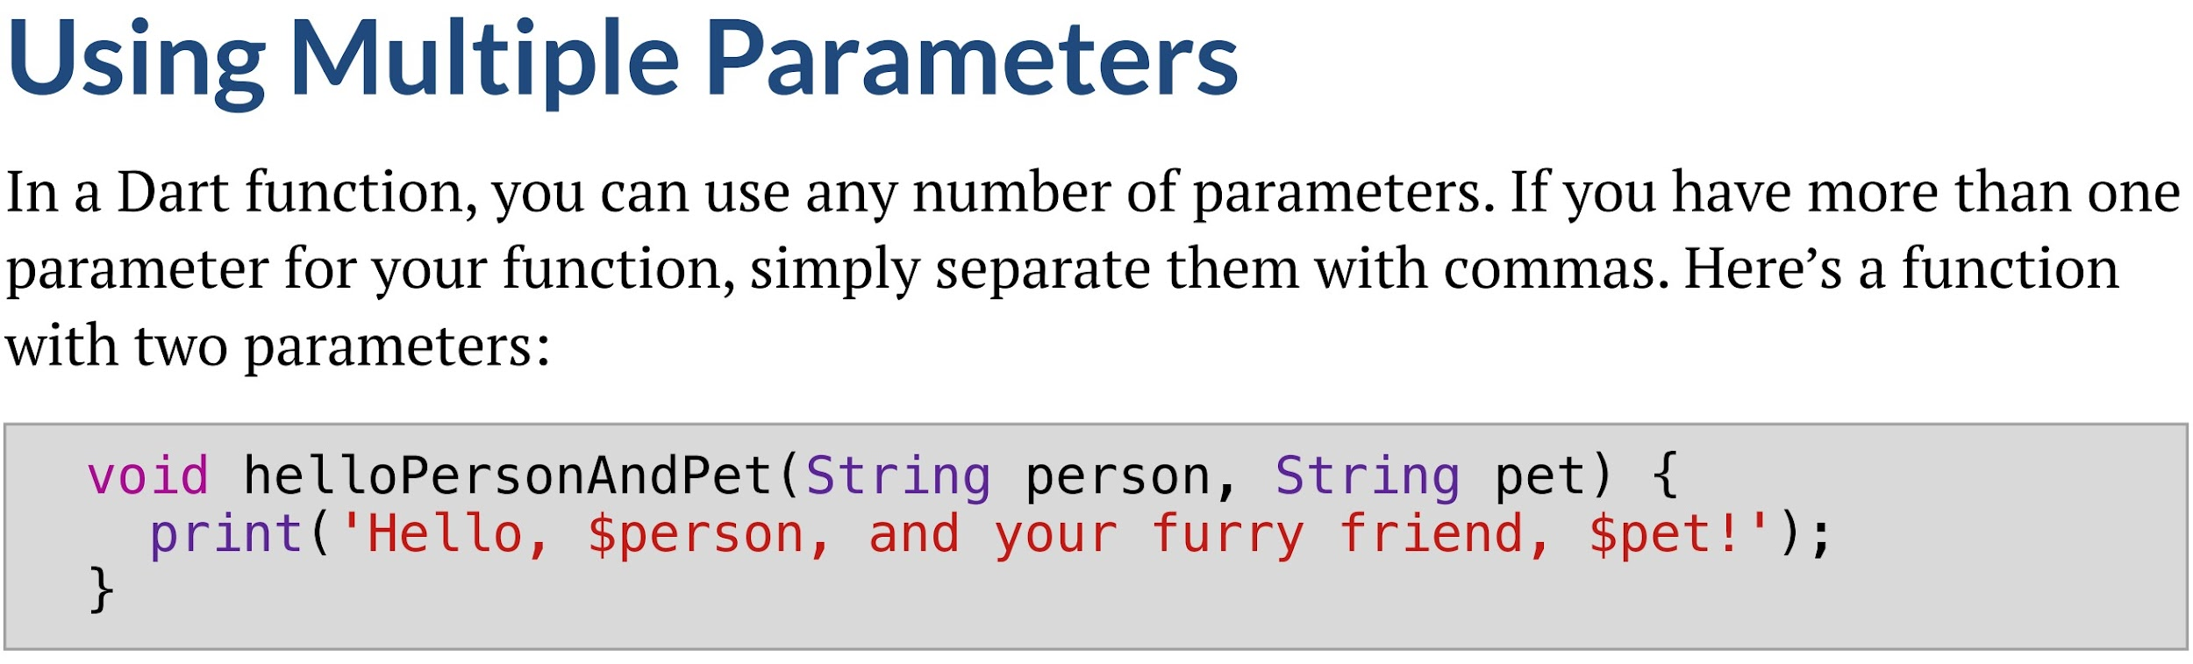
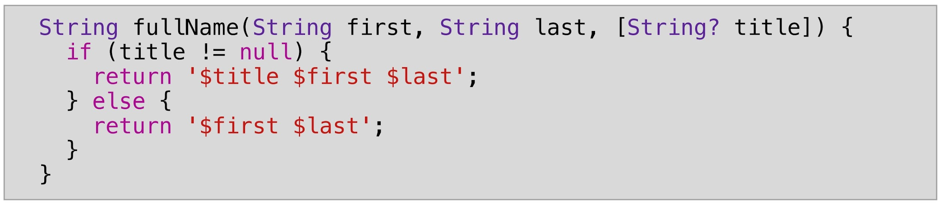
Parameters
Positional Parameters
Optional Parameter. Must be last

Slide 12
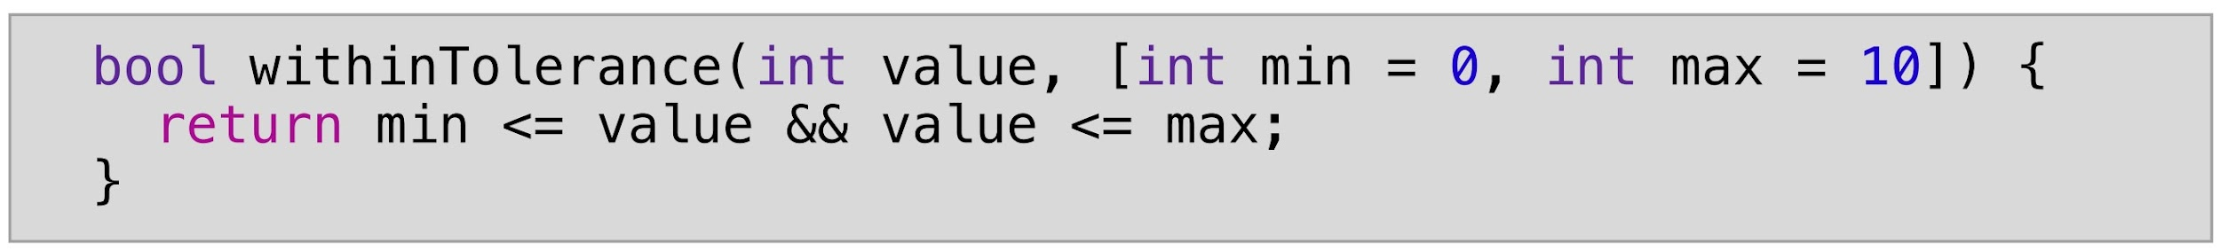
Default Values
Default values
All
correct

Slide 13
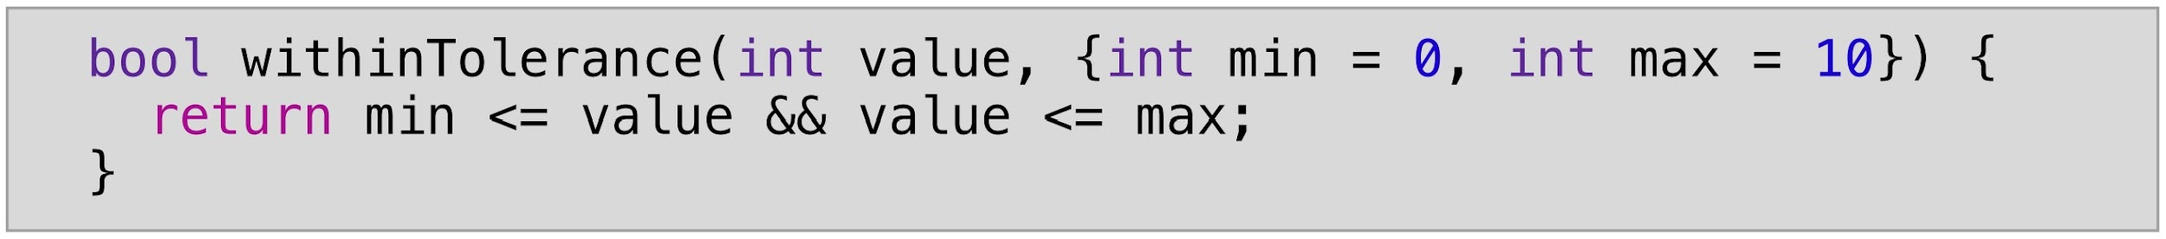
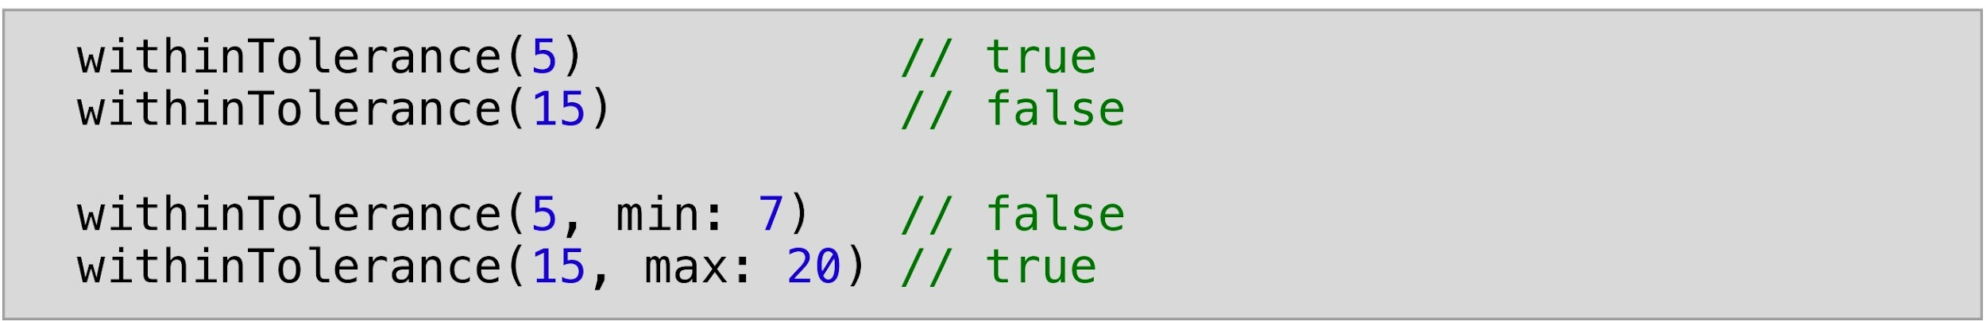
Naming Parameters
Naming Parameters
All
correct

Slide 14
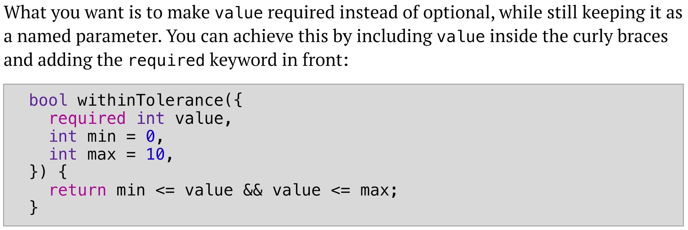
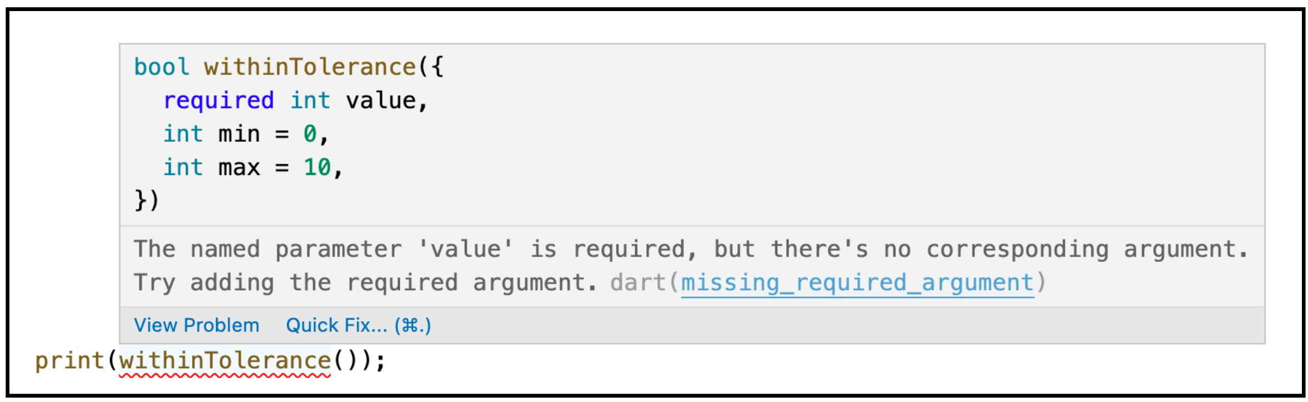
Naming Parameters (required keyword)
error

Slide 15
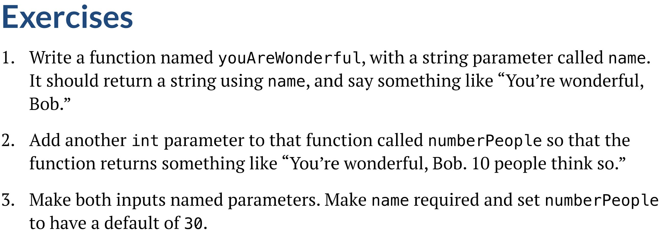
Mini Exercise

Slide 16
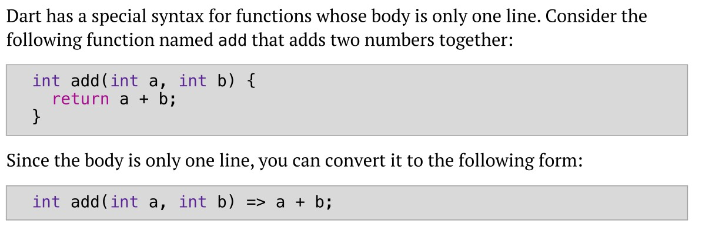
Arrow Functions

Slide 17
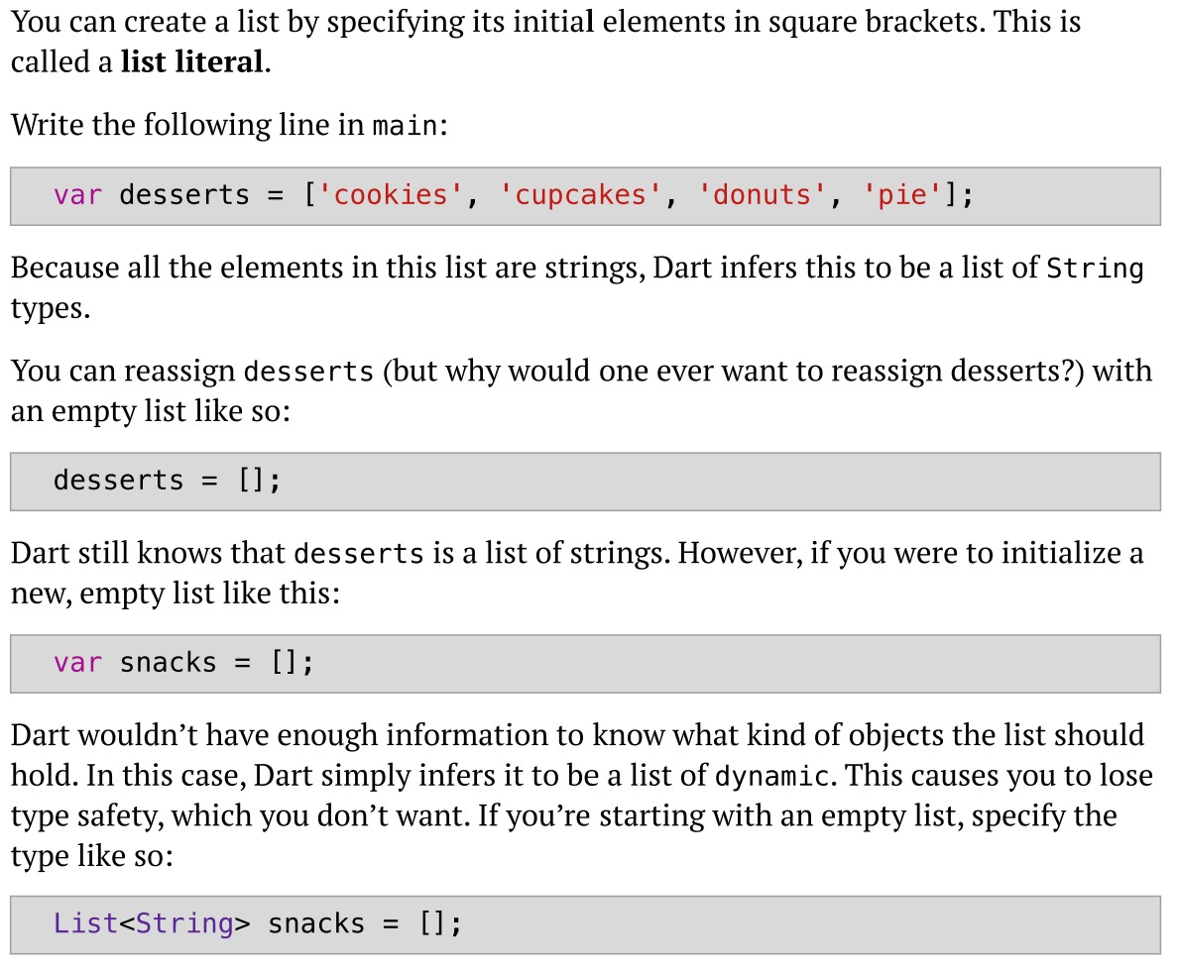
Chapter 12 Lists
type is dynamic. Bad idea!
type is String. Good idea

Slide 18
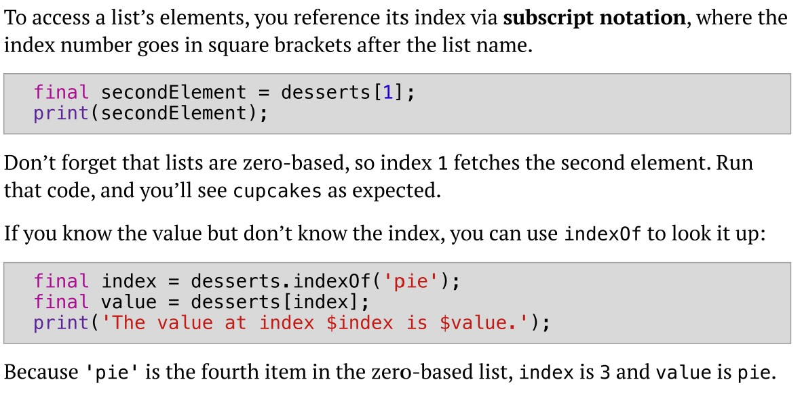
Accessing Elements
prints cupcakes
returns 3
prints The value at index 3 is pie.

Slide 19
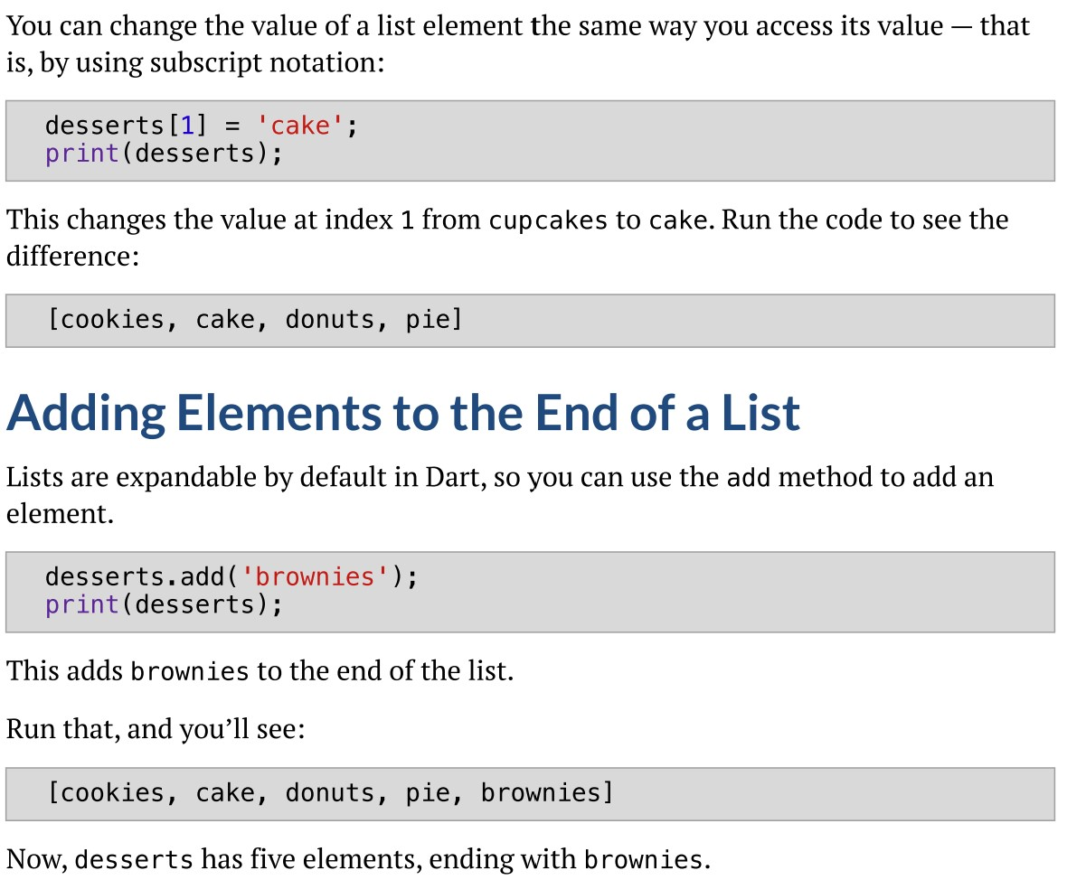
Assigning Values to List Elements
add brownies at the end of the list

Slide 20
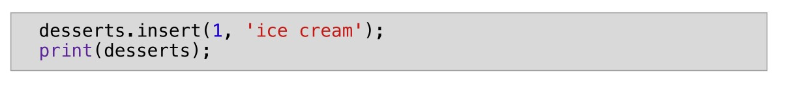
Inserting Elements
insert ice cream at location 1

Slide 21
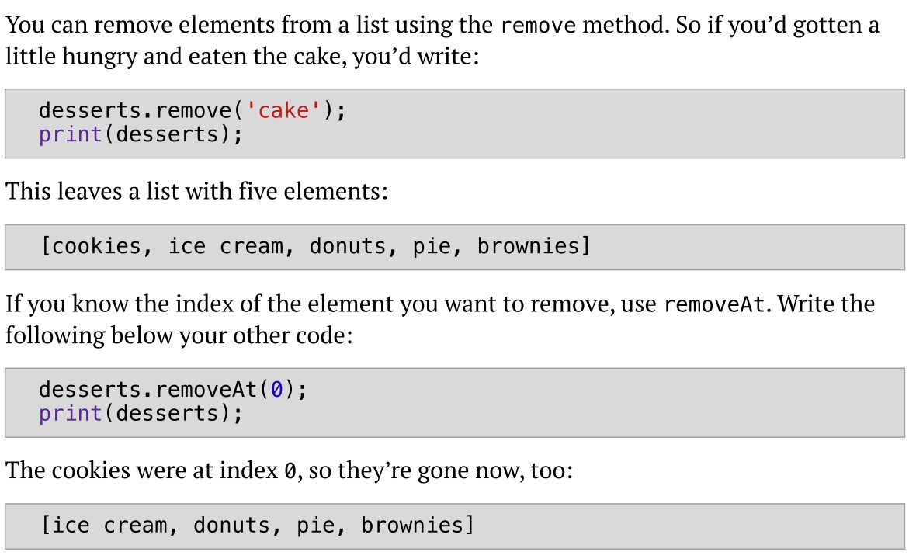
Removing Elements
remove cake from desserts
remove at index 0

Slide 22
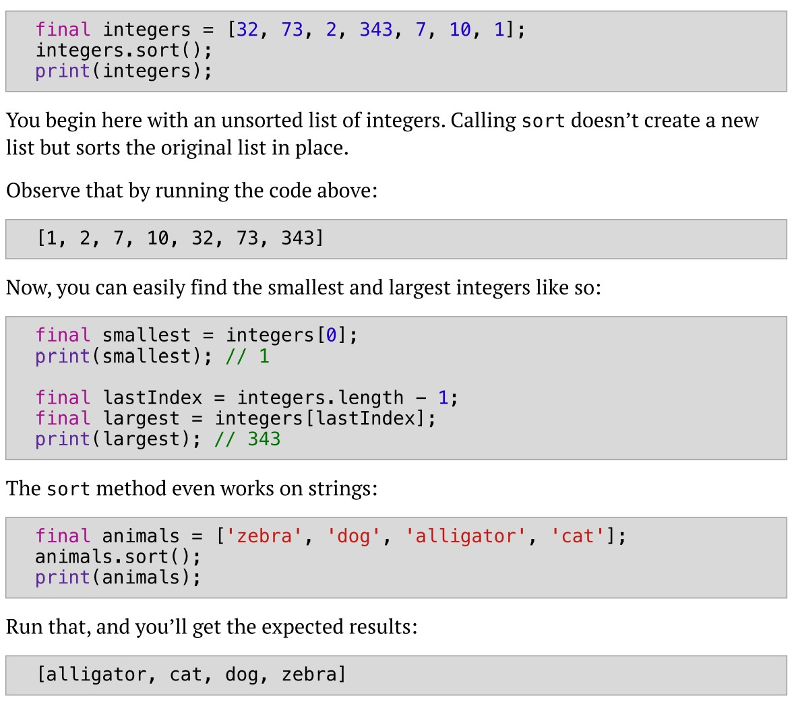
Sorting Lists

Slide 23
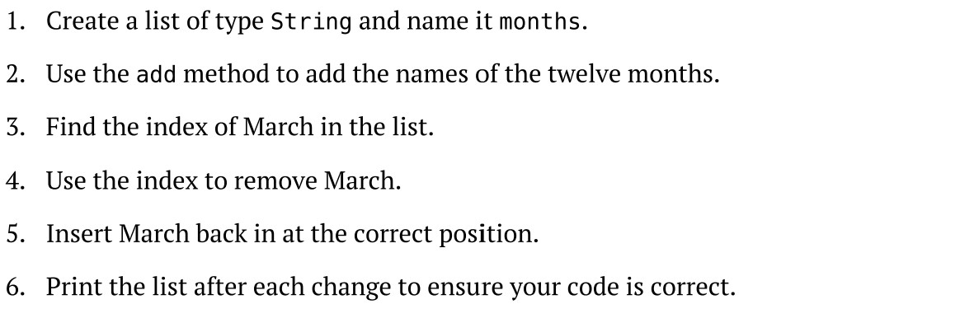
Mini Exercise

Slide 24
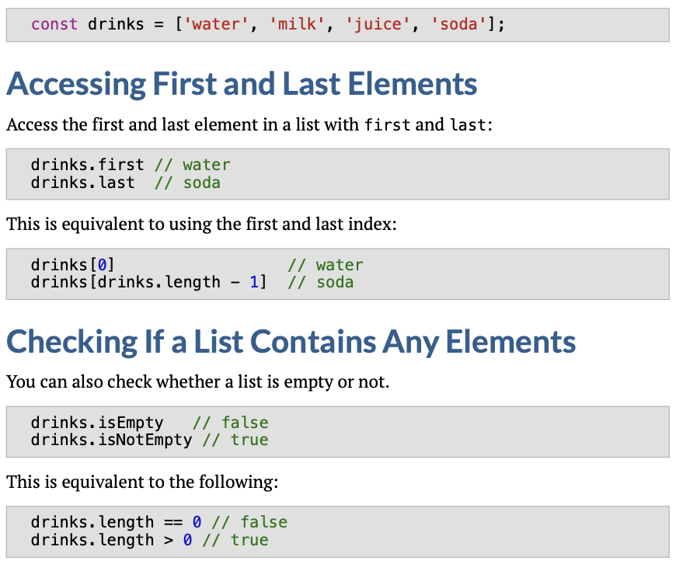
List Properties
Similar
Similar

Slide 25
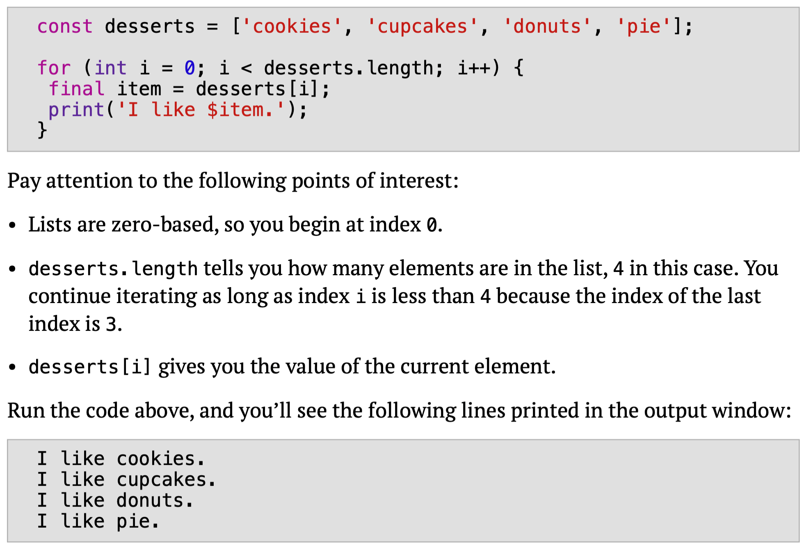
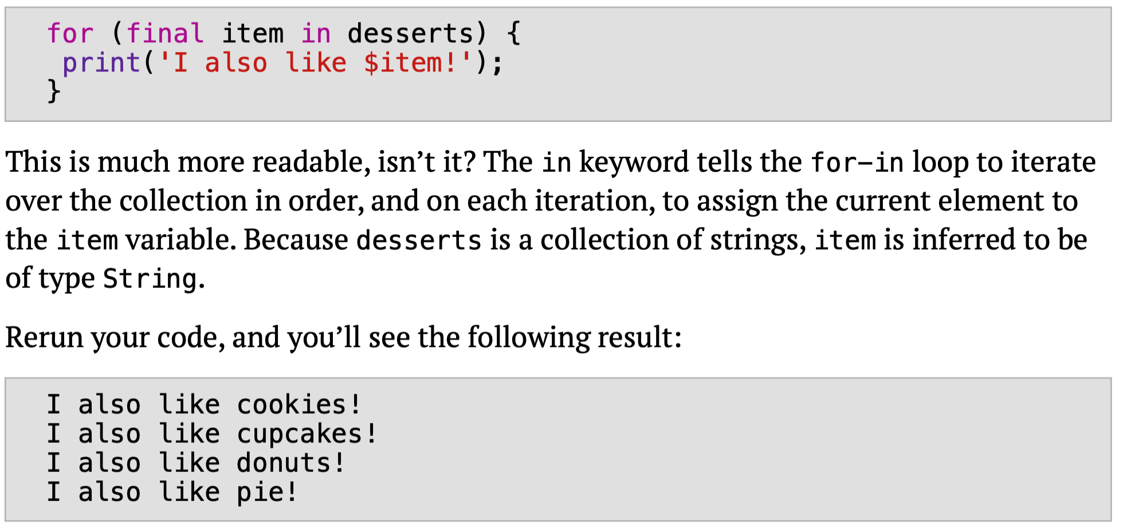
Looping Over Elements of a list
Length of a list
new type of for loop, called for-in
output
OR
output

Slide 26
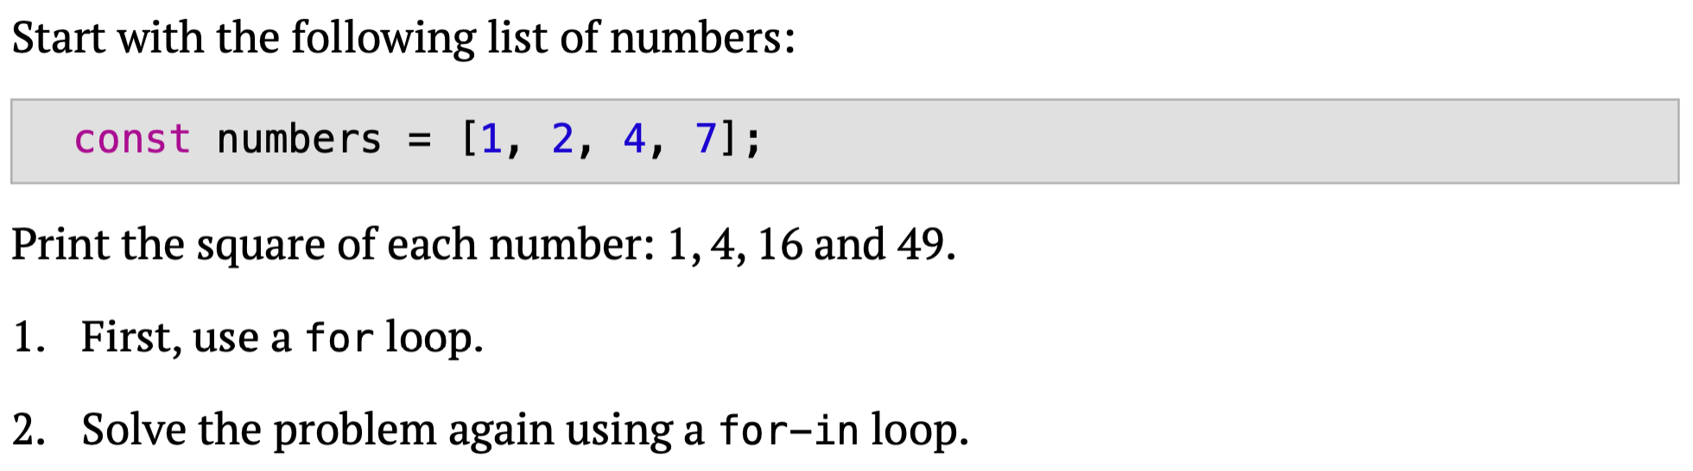
Mini Exercise

Slide 27
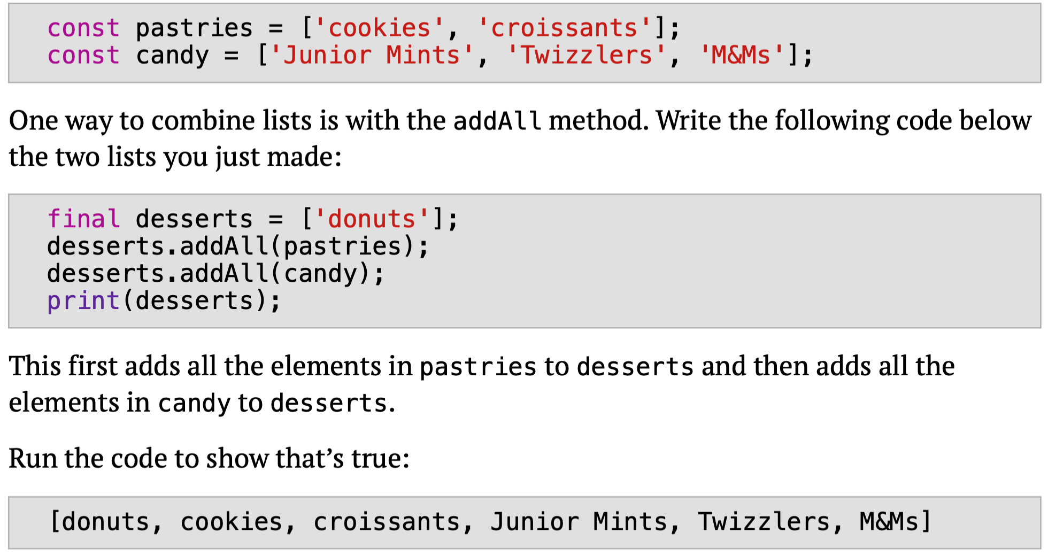
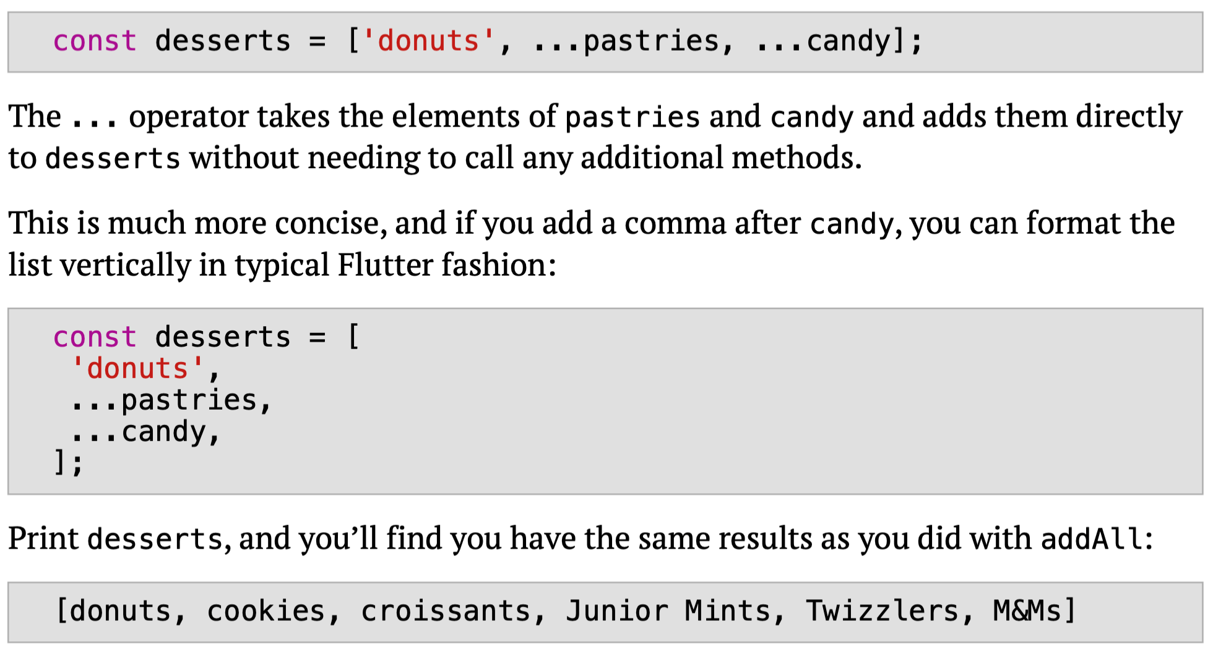
Flutter oriented commands for Lists Spread Operator (…)
add pastries and candy lists to desserts using spread operator
add pastries and candy lists to desserts
Alternatively, using flutter style
OR
important
output
output

Slide 28
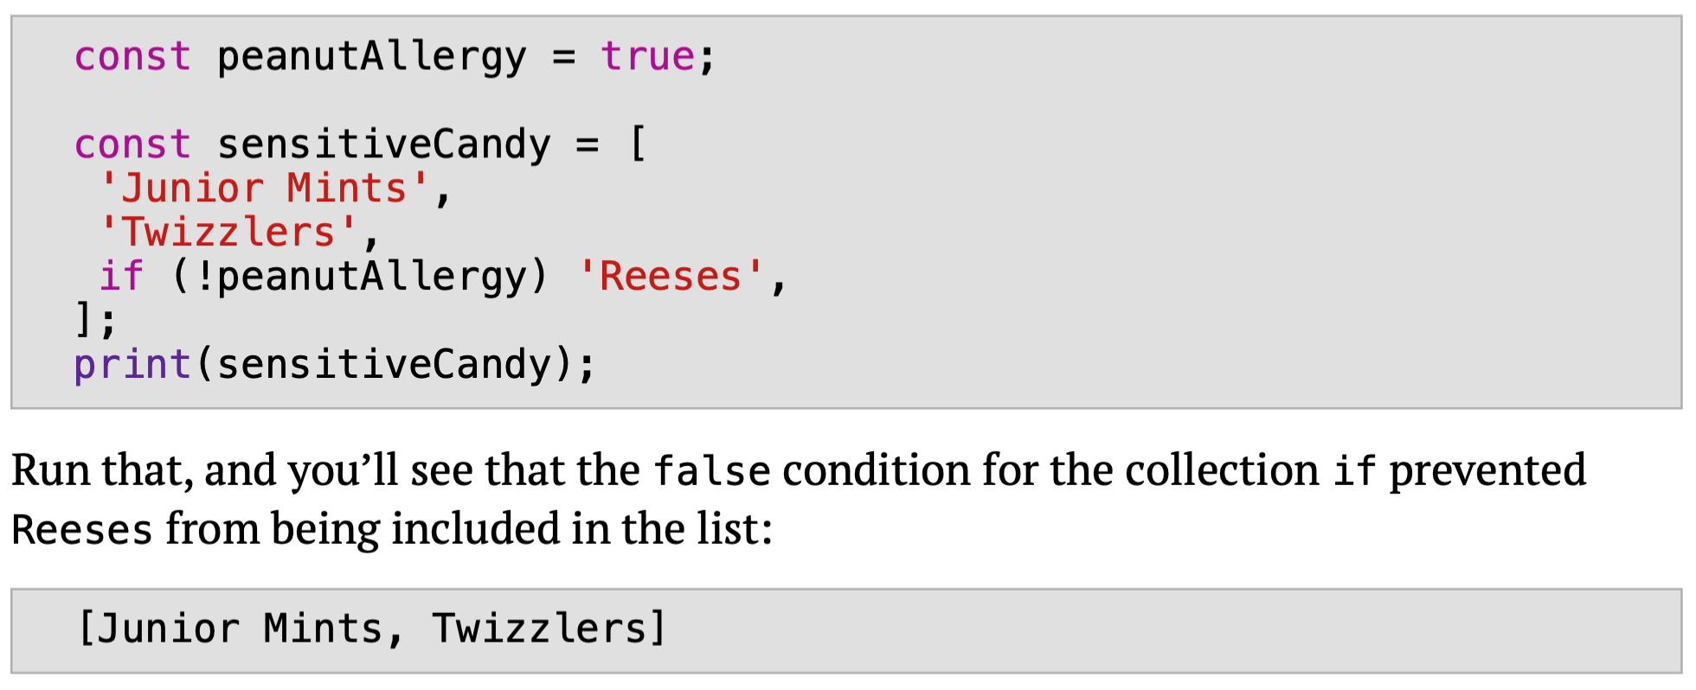
Flutter oriented commands for Lists Collection if
output

Slide 29
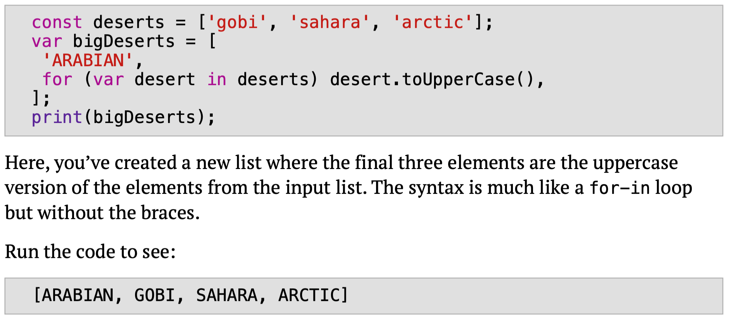
Flutter oriented commands for Lists Collection for
using for-in but without {}
output

